Slide 1
Darke County Association of Fire Chiefs

Slide 2
Darke County Association of Fire Chiefs (DCAFC)
Recognizing the need for unity, the Fire Chiefs of Darke County formed the Association in 1984:
To better serve our fellowman
To better discharge our duties
To study better methods of our endeavors
To establish a more cooperative atmosphere between all emergency and governmental agencies
To establish a medium through which an expression of ideas, practices, and exercises dealing with matters of general interest(s) for the betterment of service is accomplished

Slide 3
22 Member Departments (More than 465 Firefighting Personnel) Serving all of Darke County and portions of Mercer, Miami, Preble, and Shelby Counties (Population of about 94,887) Ansonia Laura Rossburg Arcanum Liberty TWP Russia Bradford New Madison Union City (OH) Burkettsville New Paris *Union City (IN) Gettysburg North Star Verona Greenville Osgood Versailles Greenville TWP Pitsburg West Manchester Hollansburg *Joined DCAFC in August 2023

Slide 4
In 2021, the Association became a non-profit 501(c)(3) Public Charity for purposes of providing training and education to the county’s fire service. This includes the operation and maintenance of a county training facility. In March 2023, we launched our CHIEFS’ campaign to raise funds to build a training facility for ALL of our departments.

Slide 5
Darke County Regional Fire Training Facility
CHIEFS’ Campaign
Communities Helping Improve Education of the Fire Service

Slide 6
Why do we need it?

Slide 7
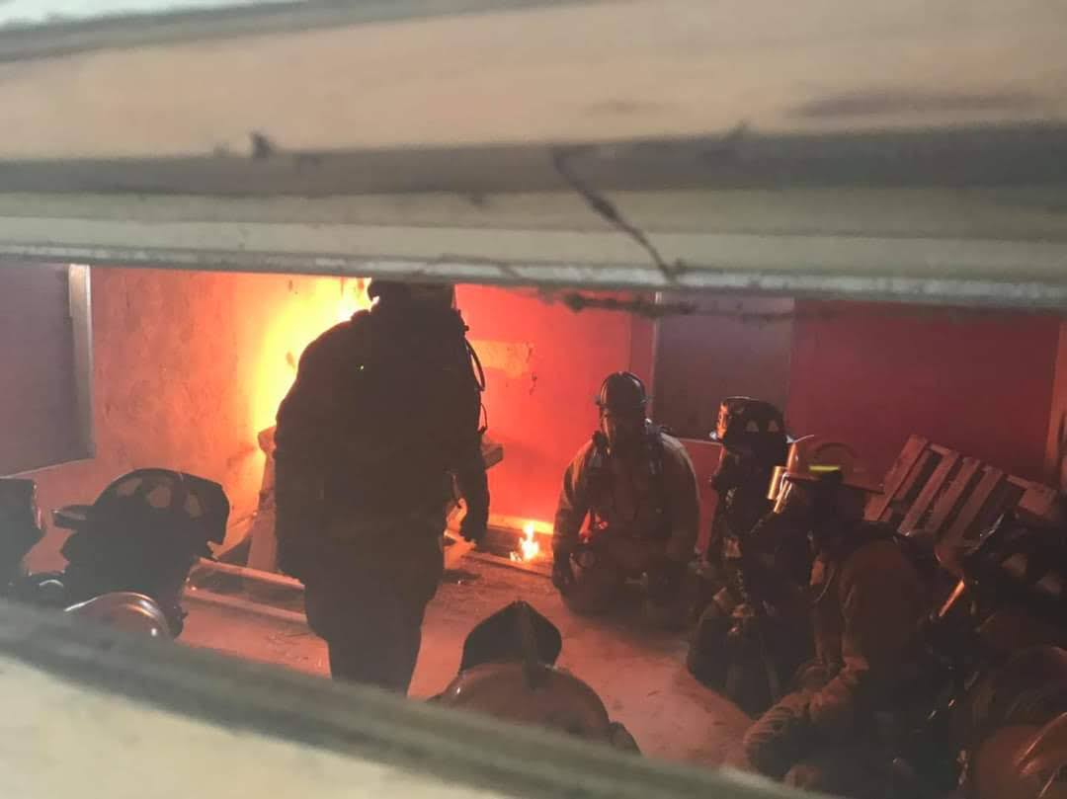
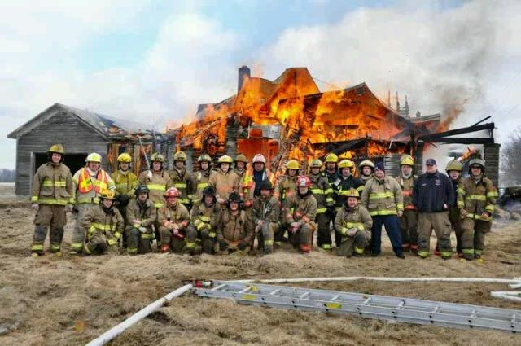
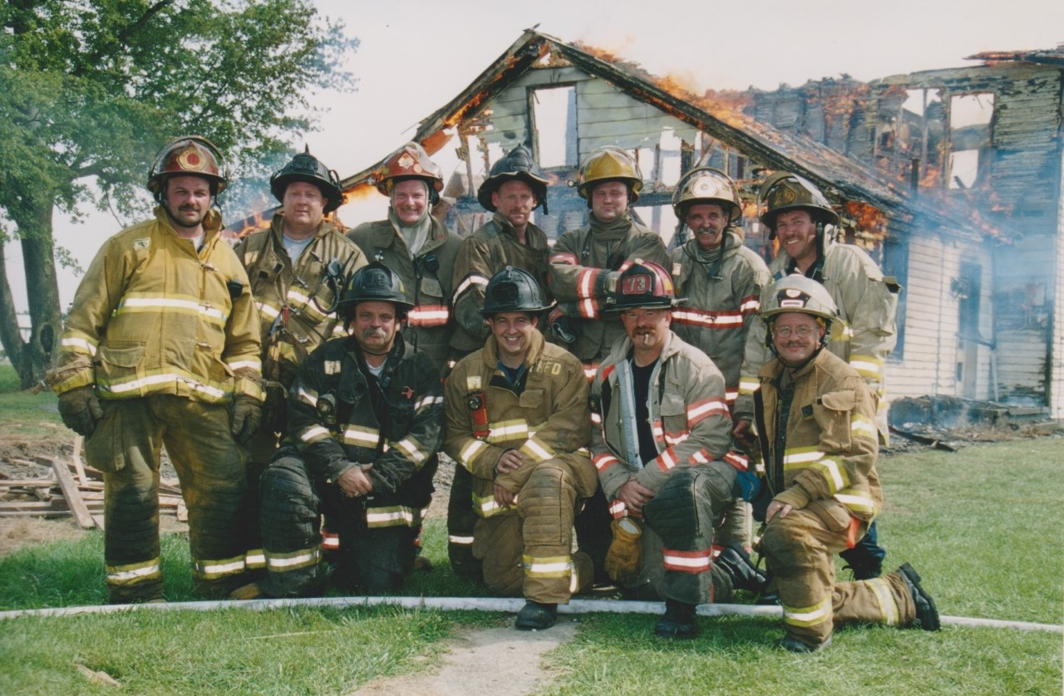
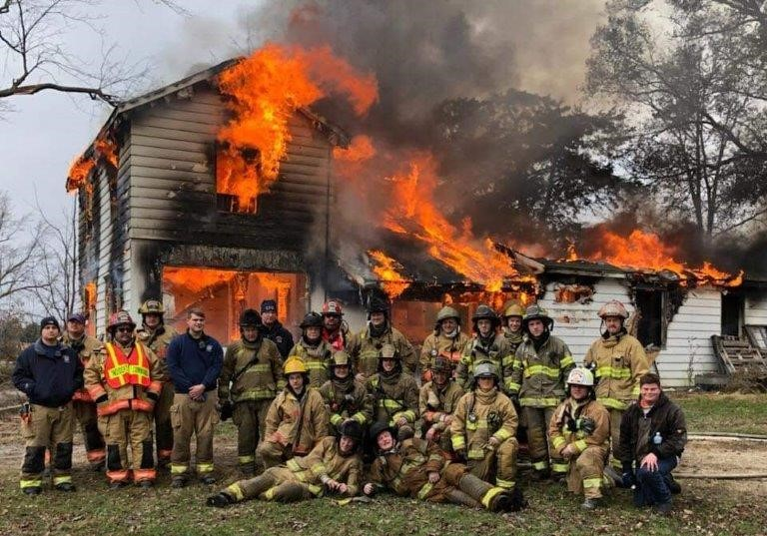
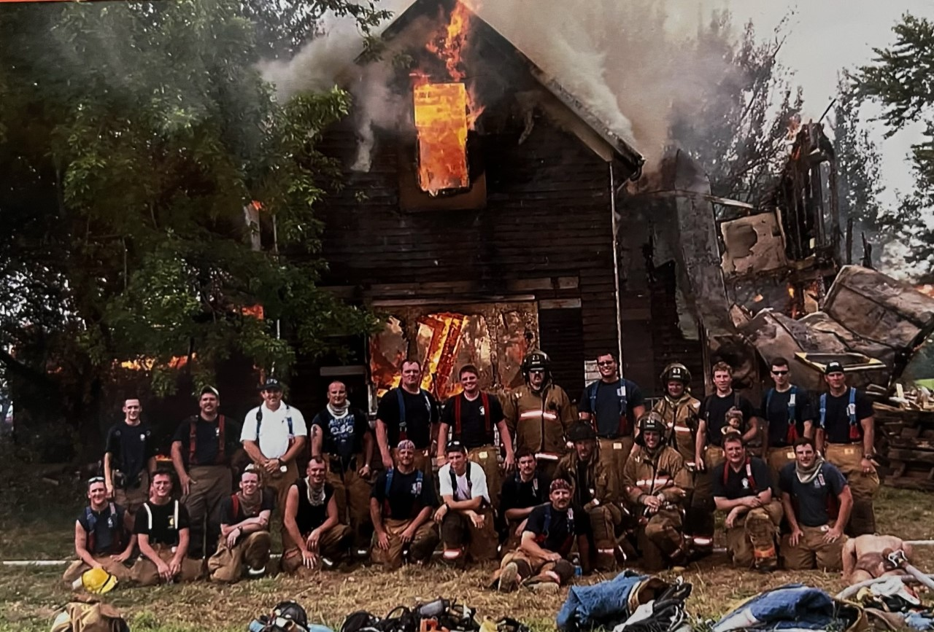
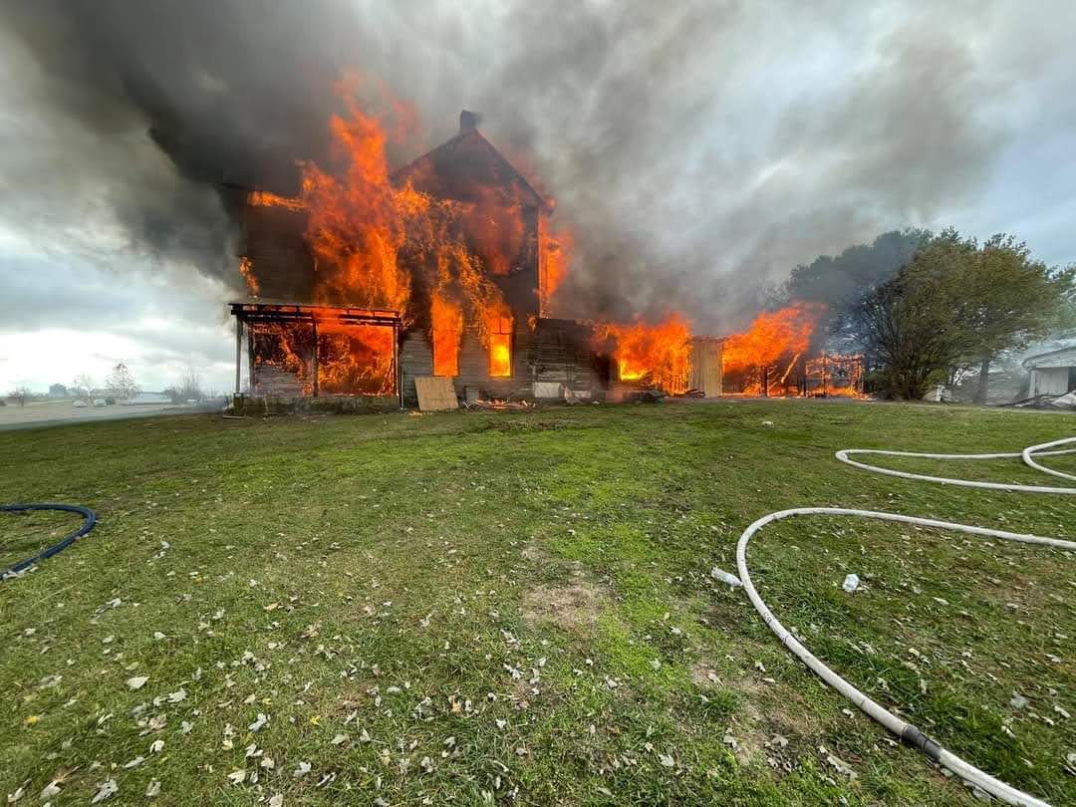
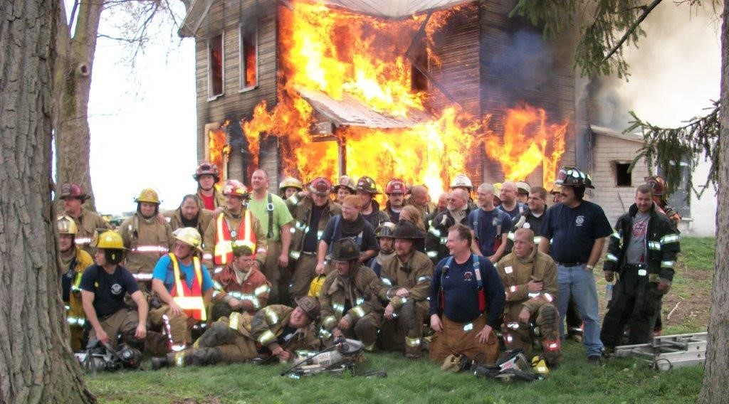
We don’t acquire & burn structures like we used to!
Stricter regulations
Financial restraints
Logistical challenges
Uncontrollable environment
Safety issues

Slide 8
It’s a live-fire training facility but so much more!
Apparatus placement and pump operations
Ground ladder deployment
Vertical and horizontal ventilation
Overhaul operations
Search
Fire ground accountability & communications
Self-rescue
Firefighter rescue
Technical rescue
We can provide safe but realistic training for our firefighters obtaining certification as well as improving the quality of training needed to meet our recertification requirements.

Slide 9
Volunteer Firefighter Certification
A Volunteer Firefighter certification (36-hour course) is the minimum level of certification required to provide firefighting services in the State of Ohio.
Is an introductory , awareness-level course with no live fire training received.
The local fire chief and authority having jurisdiction is responsible and liable for providing the additional training necessary to participate in fire department activities that exceed the training provided in the 36-hour volunteer course – including operating fire department apparatus and interior firefighting operations.
The certification must be renewed every three years, with fifty-four (54) hours of continuing education required during each three year cycle.

Slide 10
Firefighter I Certification
The Firefighter I (FFI) certification (160-hour course) is the minimum level of certification recommended to provide firefighting services in the State of Ohio.
The course includes firefighter training, hazardous materials awareness, and hazardous materials operations level training. In addition to the Firefighter I course, students are required to complete an Emergency Vehicle Operations Course and training on the National Incident Management System (NIMS).
The certification must be renewed every three years, with fifty-four (54) hours of continuing education required during each three year cycle.
The Firefighter I (FFI) Transition Course (124-hour course) allows those certified as a Volunteer Firefighter to transition from the Volunteer Firefighter certificate to a Firefighter I certificate.

Slide 11
Firefighter II Certification
The Firefighter II (FFII) certification (240-hour course) is the highest level of firefighter certification available in the State of Ohio; typically required for career firefighters in the State.
The certification must be renewed every three years, with fifty-four (54) hours of continuing education required during each three year cycle.
The Firefighter II (FFII) Transition Course (84-hour course) allows those certified as a Firefighter I to transition from the Firefighter I certificate to a Firefighter II certificate.

Slide 12
Ever-changing fire characteristics and technologies require firefighters to receive advanced education and training in fire suppression, fire prevention, rescue, and emergency medical services. A proper learning environment is critical for delivering this education throughout a firefighter’s career. This fire training facility provides a safe but effective environment for fire training and enhances the community’s well-being through better fire protection and fire prevention.

Slide 13
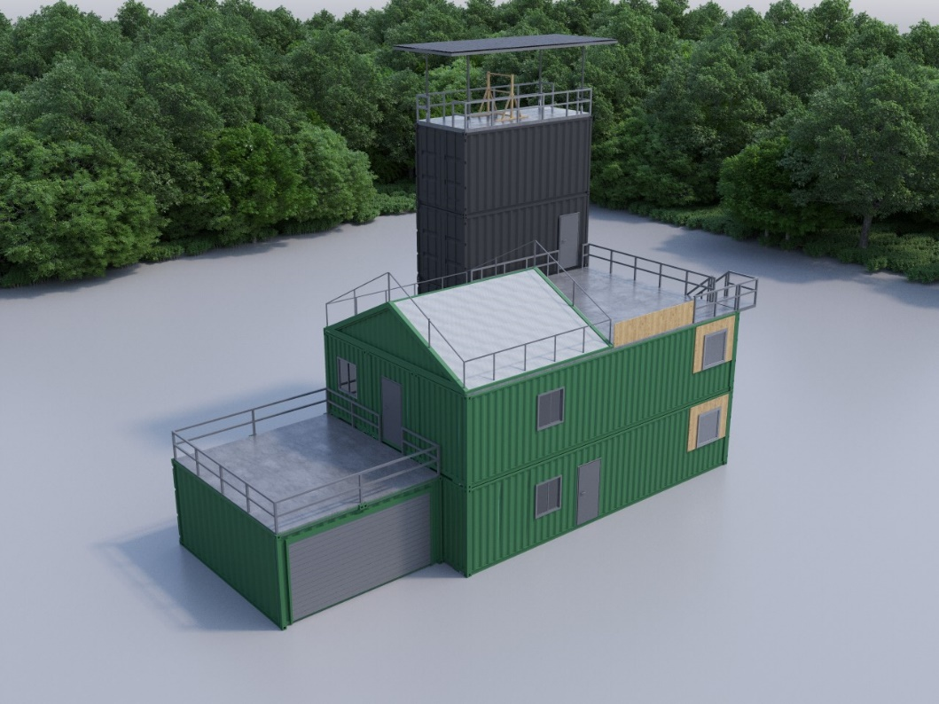
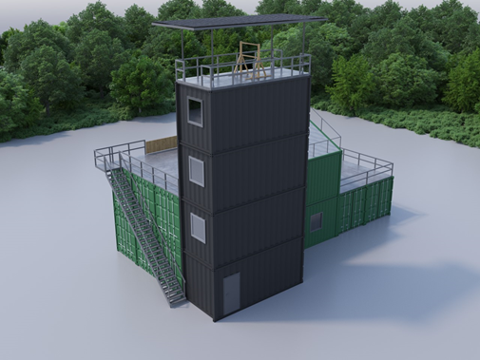
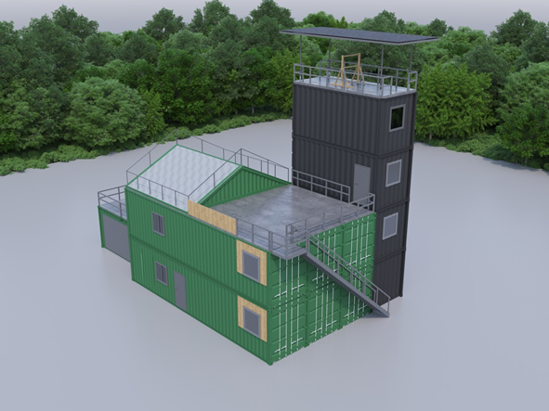
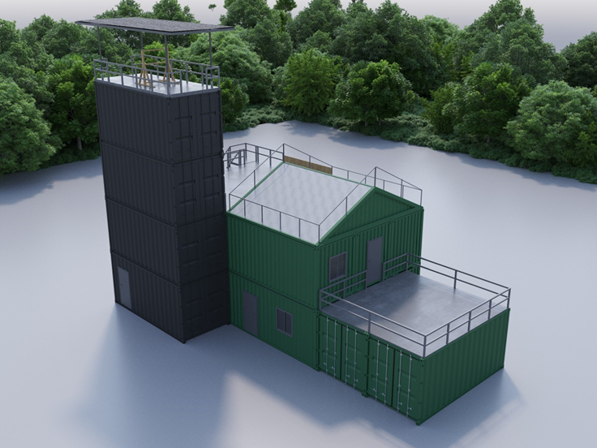

Slide 14
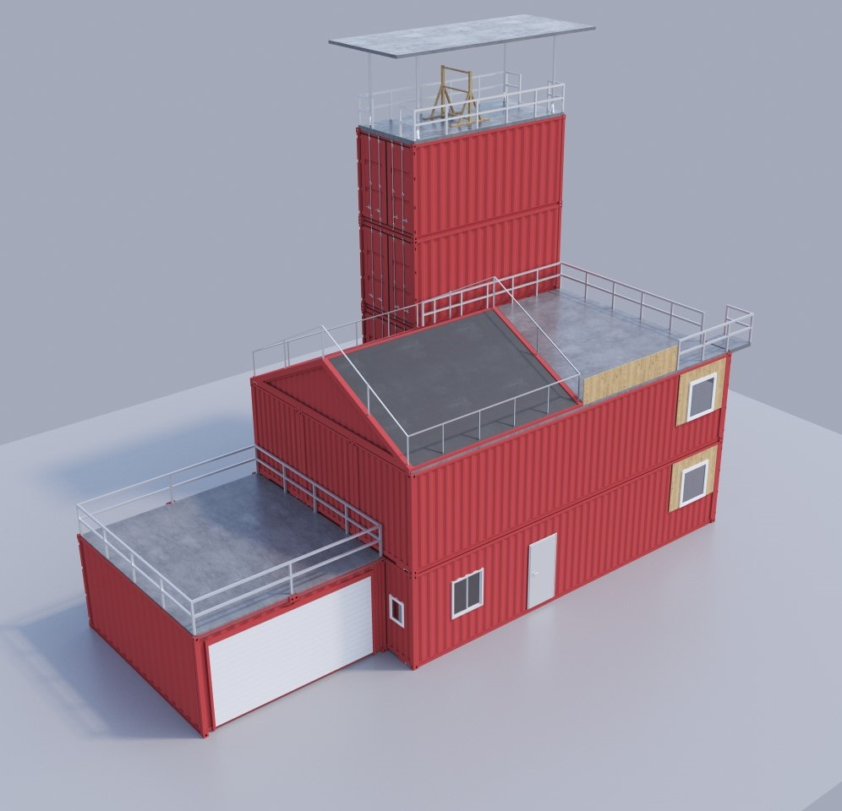
Live fire training facility fabricated from new shipping containers estimated at $750,000.00 (does not include additional infrastructure costs)
Total of six 40’ containers & six 20’ containers
Four 20’ containers for training tower
Six 40’ containers & two 20’ containers representing a two-story residential structure with attached two-car garage
Two Class B (propane) burn rooms (one on each floor) and one Class A (ordinary combustibles) burn room (1st floor)
More than 4,300 square feet of training area

Slide 15
Level 1 Floorplan

Slide 16
Level 2 Floorplan

Slide 17
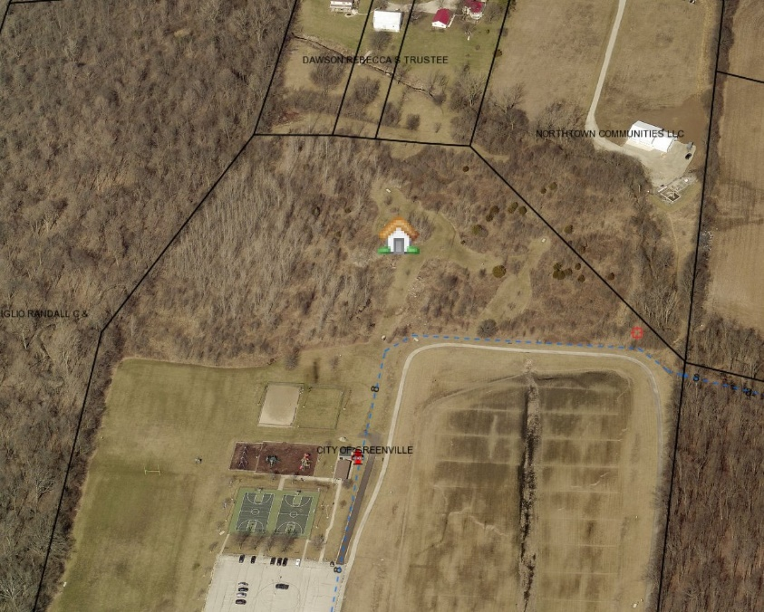
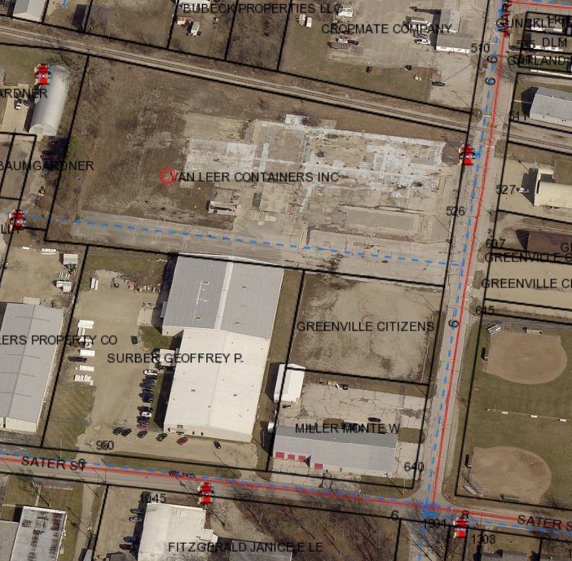
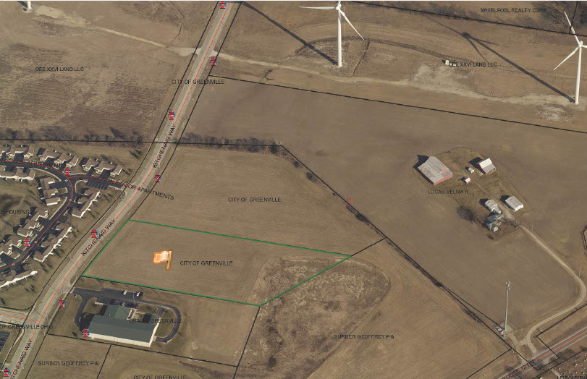
Greenville provides a central location
Option #1
Vacant Van Leer lot on
Markwith Ave.
Option #2
North of North Park
Option #3
On Kitchen Aid Way, just
north of Greenville Transit

Slide 18
DCAFC has a revenue stream to maintain and operate such a facility. We don’t have the capital to build it!

Slide 19
We are asking our communities to invest! Our fire departments, residents, businesses, local governments, and if necessary, the State of Ohio.

Slide 20
No donation is too small, and every contribution matters!

Slide 21
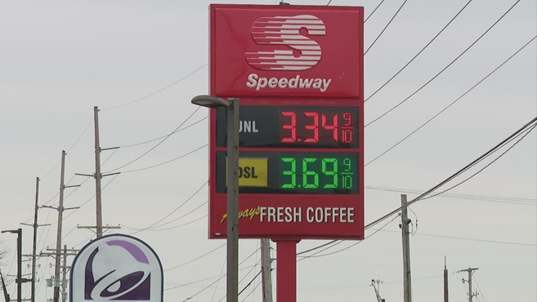
In a simple world, a $10.00 donation for every resident would generate $948,870.00.

Slide 22
The value of live fire training is difficult to calculate because it’s impossible to put a value on human life. Saving lives and avoiding injury are the ultimate reasons for making an investment. There is simply no substitute for live firefighting experience under safe, controlled conditions. The potential benefits of this facility include:
Contributing to a continuation of an effective fire service
Reducing injuries and deaths of civilians and firefighters
Reducing lost time injuries and compensation claims
Reducing property damage
Reducing property loss and business interruption resulting from fire
Increasing efficiency and morale of the firefighting force
Improving training capability of the fire departments
Improving public image of the fire service throughout the county
Improving fire service recruitment and retention
Improving ISO (Insurance Services Office) ratings for fire departments

Slide 23
PLEASE DONATE NOW!
Fire Commissioner Sponsorship $150,000+
Fire Chief Sponsorship $100,000 - $149,999
Deputy Chief Sponsorship $50,000 - $99,999
Assistant Chief Sponsorship $25,000 - $49,999
Battalion Chief Sponsorship $10,000 - $24,999
Captain Sponsorship $5,000 - $9,999
Lieutenant Sponsorship $1,000 - $4,999
Firefighter Sponsorship $500 - $999
Recruit Sponsorship $1 - $499

Slide 24
All supporters of the Darke County CHIEFS’ Campaign who donate $500.00 or more will be recognized on a sponsorship sign/billboard/monument (design TBD) on site once the project is completed.

Slide 25
If you would like to contribute to the success of this CHIEFS’ Campaign for the Darke County Regional Fire Training Facility, please make a check payable to DCAFC with CHIEFS’ Campaign on the memo line, and mail it to the Darke County Association of Fire Chiefs, 3157 Byrket Rd., Greenville, Ohio 45331

Slide 26
Donations can also be made: At any Greenville National Bank location From our website: https://www.darkecountyfirechiefs.org https://www.paypal.com/US/fundraiser/charity/4323636 https://www.gofundme.com/f/chiefs-campaignregional-fire-training-facility

Slide 27
You can follow us!

Slide 28
Thank you for your thoughtful consideration of this opportunity. If you would like more information, please contact one of the following:
Chief Russ Thompson, Campaign Chairman
Greenville Fire Department
(937) 548-3040 or (937) 459-8433
rthompson@cityofgreenville.org
Chief Brian Pearson, Campaign Vice-Chairman
Versailles Fire Department
(937) 423-4164
BrianPearson@versaillesoh.com

